Slide 1
“Measure, then look at the data.”
Engineering: How can we:
Design a process to obtain a desired outcome.
Measure the results.
Improve the process. Improve the measuring.

Slide 2
Topic: Vaccination;
Process to induce an optimal immune response in the host to protect against an environmental or endogenous threat.
Research Project Proposals:
How can we use vaccination to protect against complications from infection/cancer?
How can we measure the effects of vaccination?
How can we improve vaccination? How can we improve measuring?

Slide 3
Undergraduate Research Projects
Utilizing existing tools and data:
How can we measure the effects of vaccination?
Are there any markers of a successful vaccination?
What is the optimal volume of a blood sample needed to determine if a vaccination was successful?
When should blood samples be taken?

Slide 4
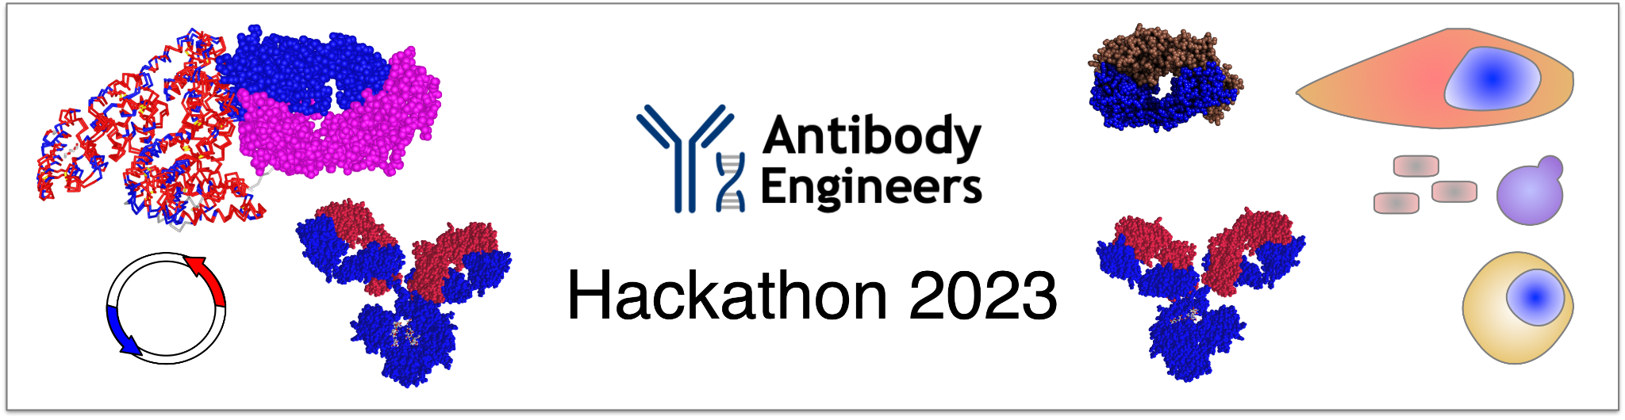
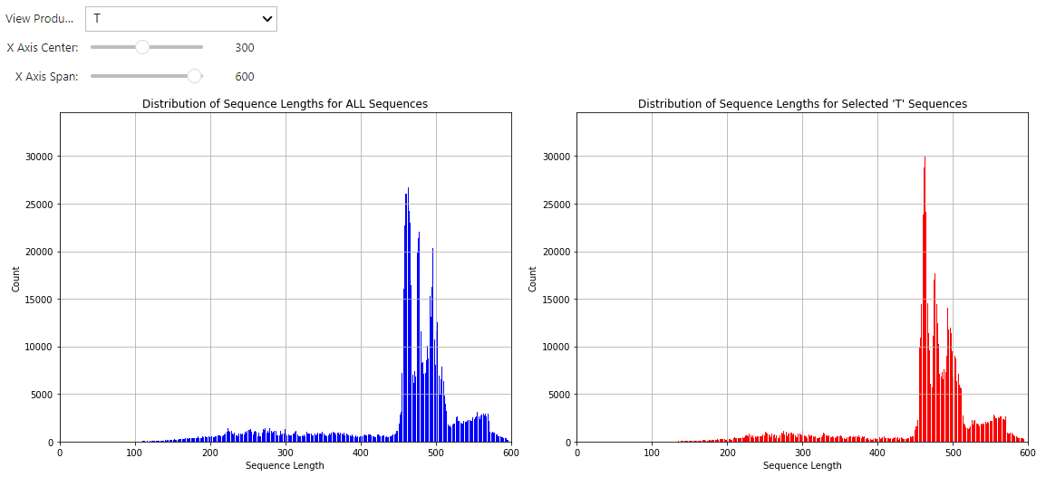
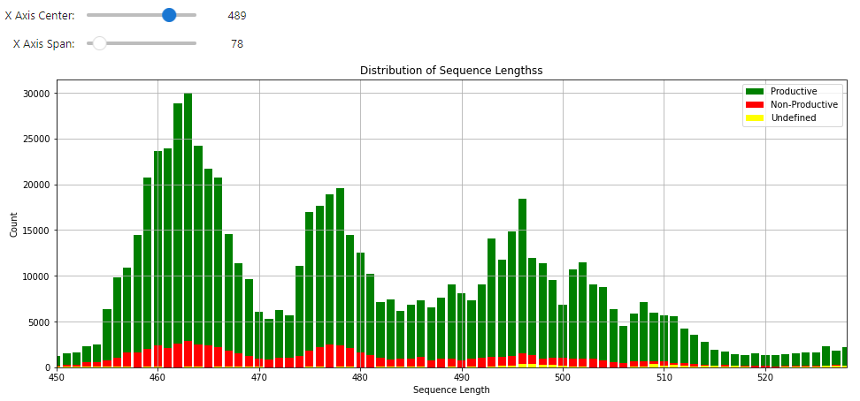
Q: How can we measure the effects of vaccination?
R.P.P.: Immunoprofiling?
Start
Find data
Look at it
Informative
as-is?
Present it
Can it be
processed?
Process it
More
Time?
Done

Slide 5
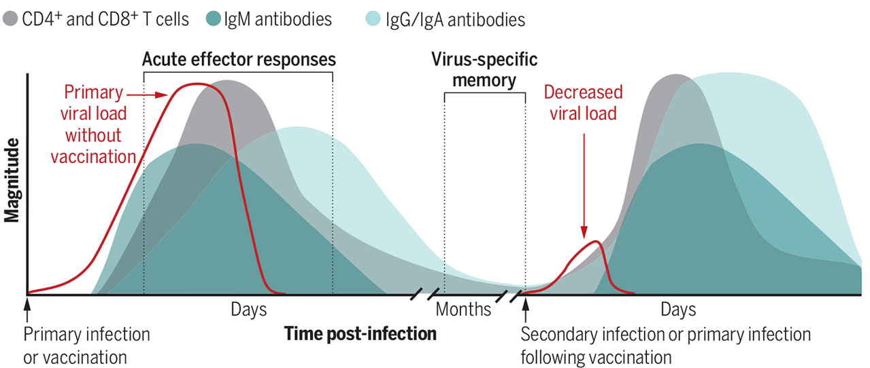
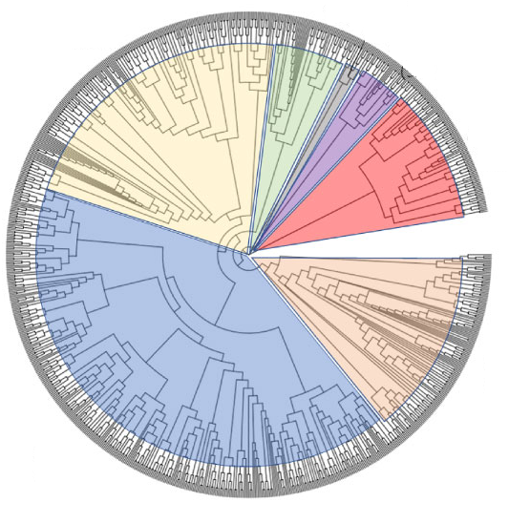
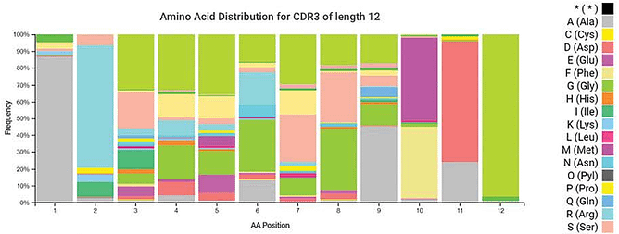
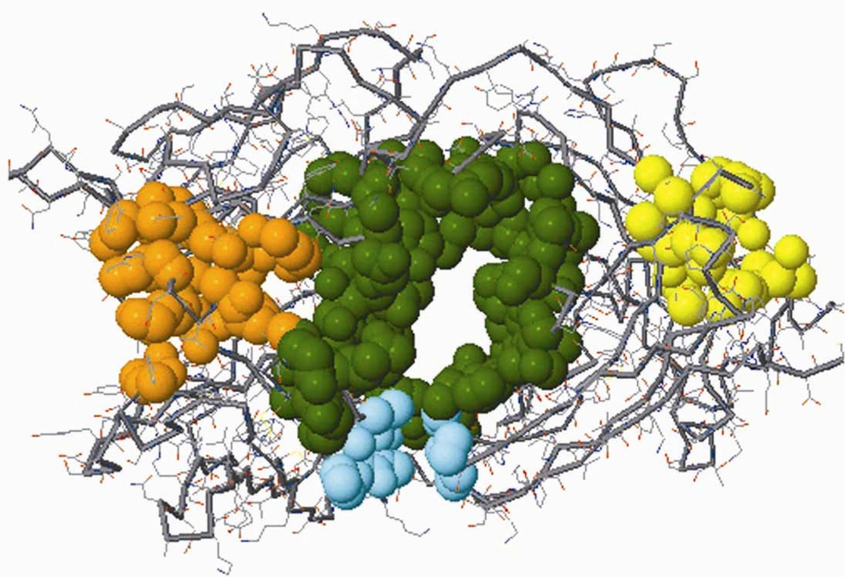
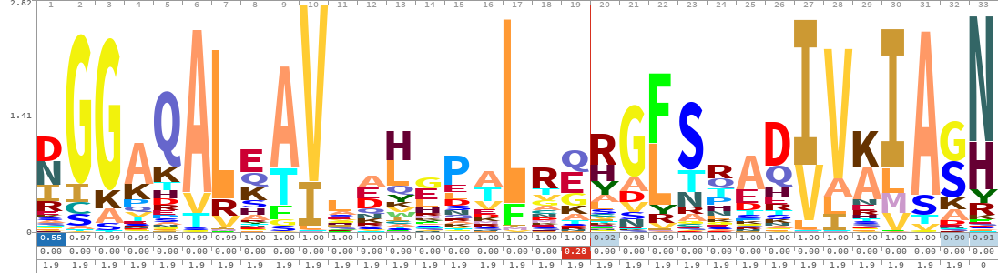
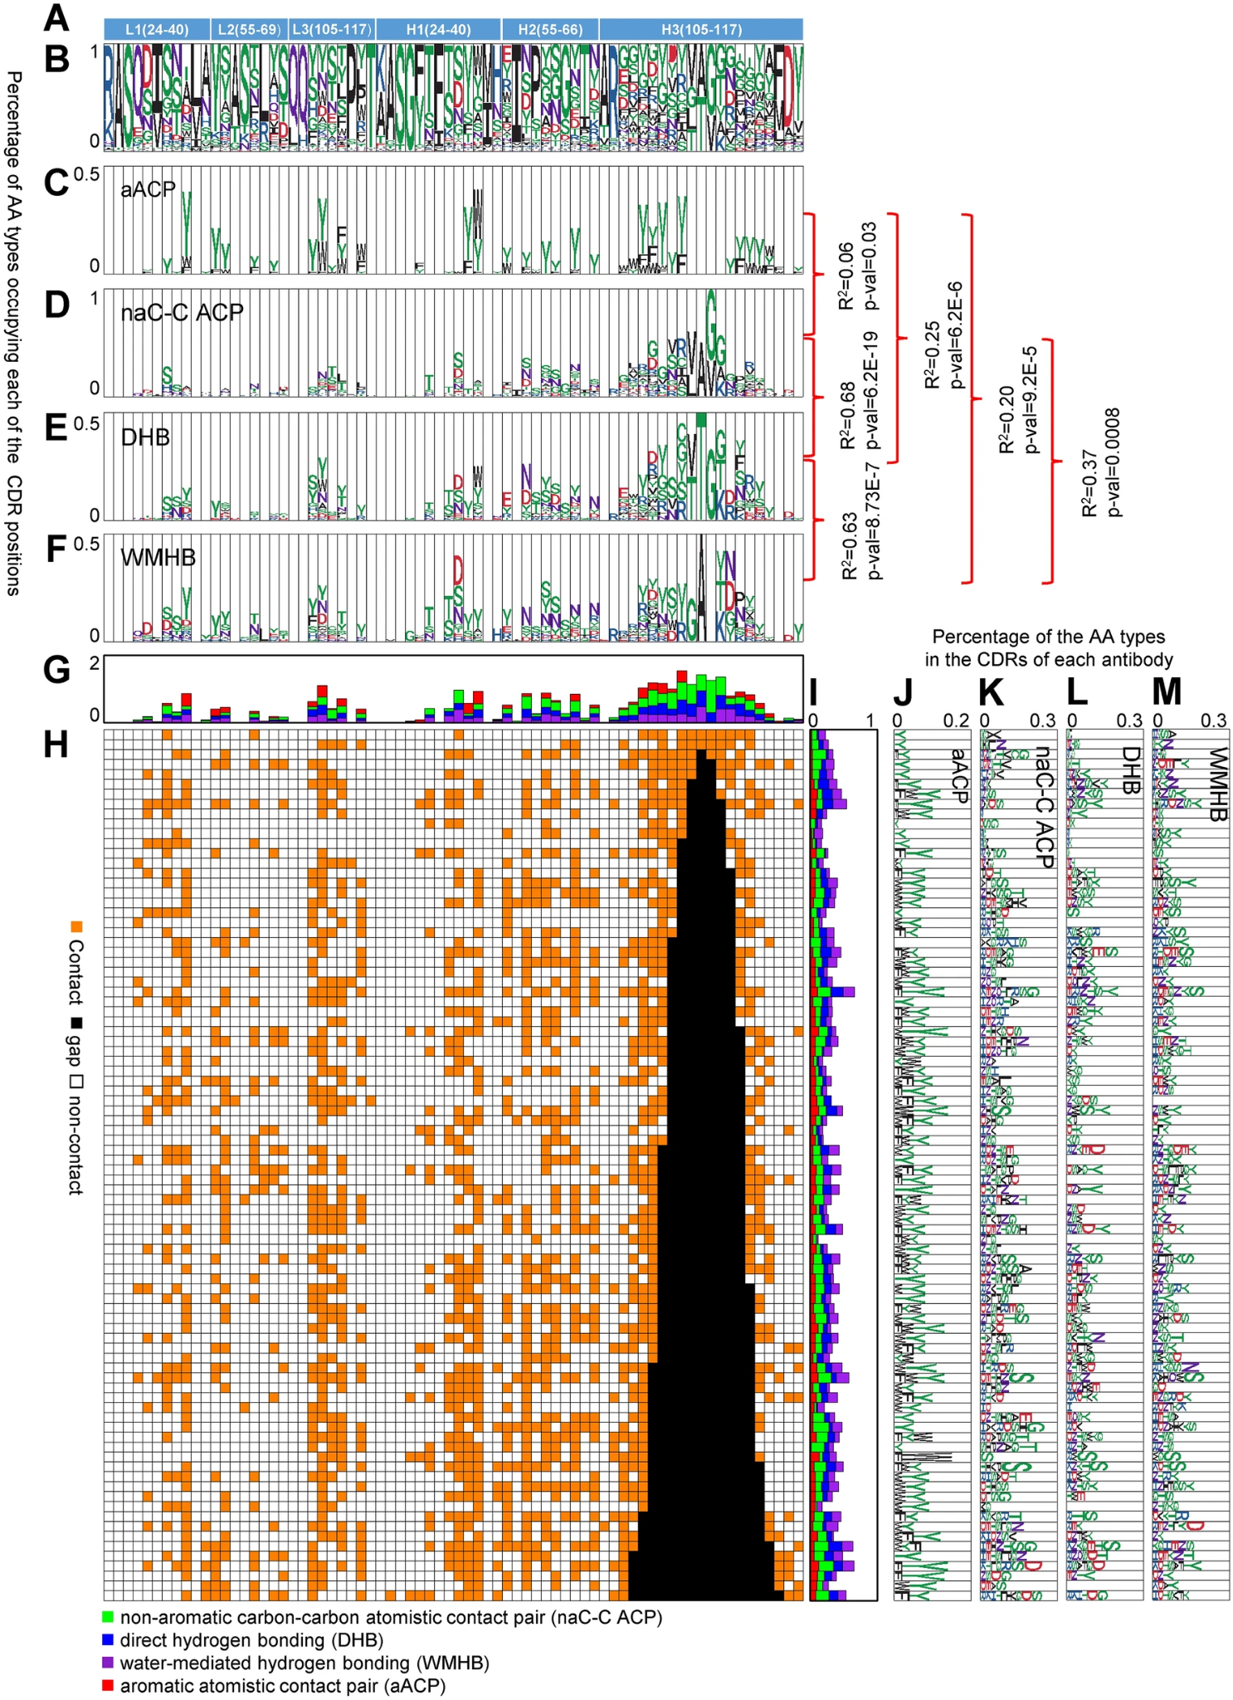
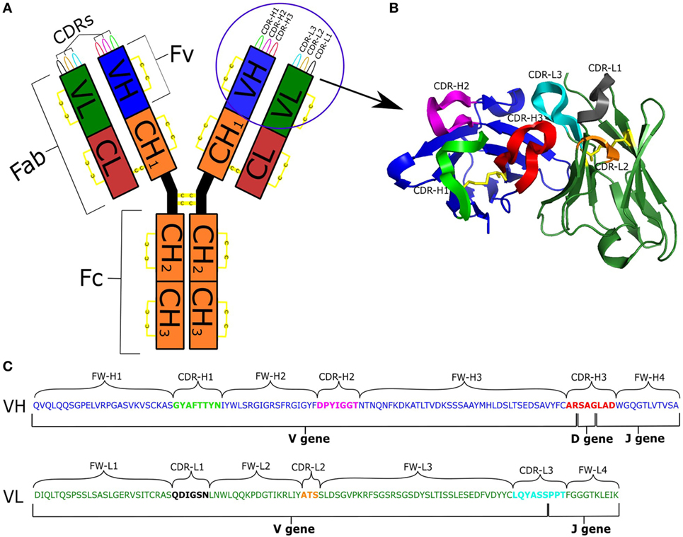
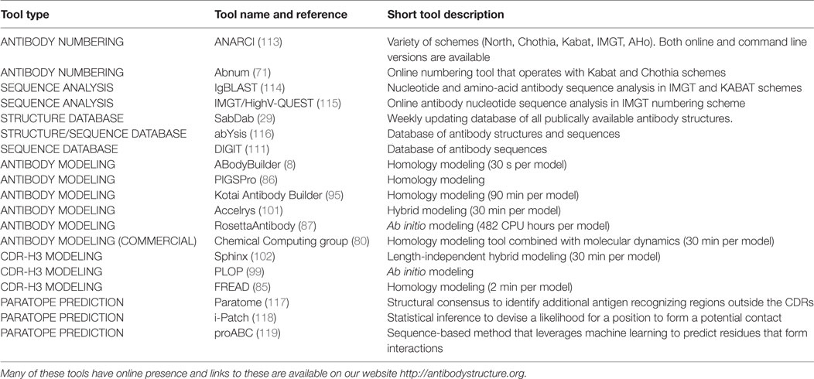
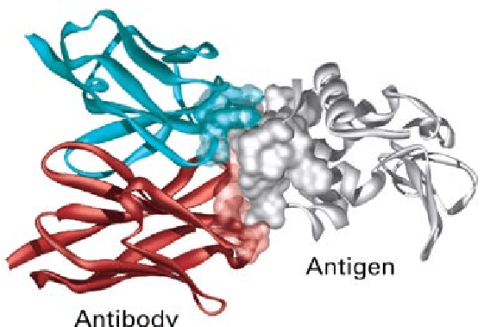
Informative Data Targets and Sources

Slide 6
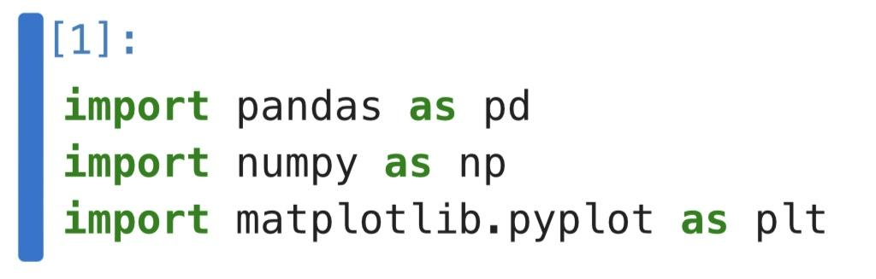
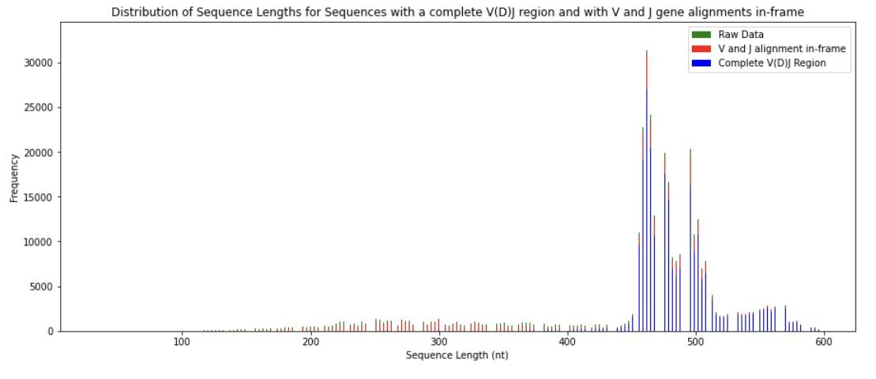
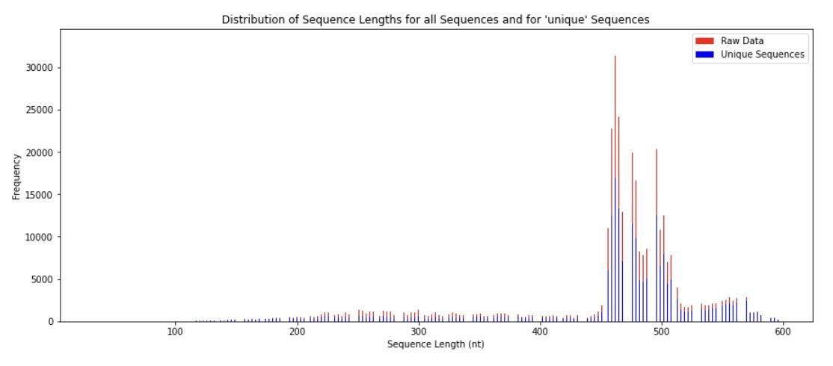
Learning the Bioinformatics tools used in Immune Profiling

Slide 7
What’s next?

